Slide 1
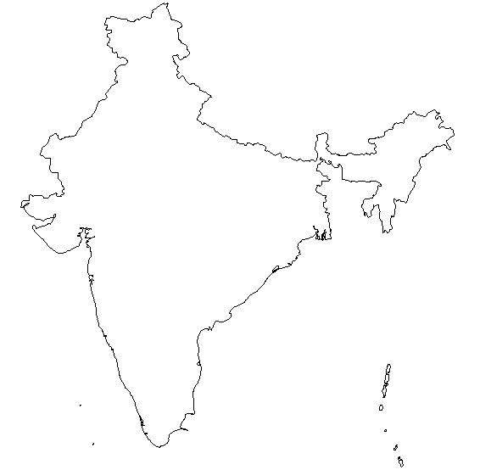
Amit Kamat’s Resume [ 07740704609 | amit.r.kamat@gmail.com | British ]
Bachelors Degree – Electronics
1989/93
Project Management
Business Knowledge/Finance
Network Technology
Certified Financial Analyst
2009
Professional Scrum-Master
2012
Novell Netware Engineer
1995
Lotus Domino Developer
1996
Lotus Domino
Java Certified Developer
1999
ACADEMIC
Java / Web Technology
Prince2 Professional
2009
Project MP
2012
1996
1998 - 2002
TULEC
System Support Engineer
Microland Limited
System support executive
CSC Limited
Lotus Domino Developer
JPMorgan Chase
Java Web Developer
1993 -1995
1997
2003 - 2005
JPMorgan Chase
Senior Project Manager
2006 - 2012
Digital Equipment Limited
Technology Consultant
Professional
Novell Netware administration and support
Hardware Support
Lotus Domino Server support & Installations
User application support
Novell Netware administration and support
Hardware Support
Training
- automated revenue reconciliation process
- Straight Through Processing framework
- RCP client for trade capture
- KPI reporting framework
- Wireframe and business logic implementation in trade capture process
- Trade blotter for management and reporting.
- Java, XML, Sybase, JavaScript, Velocity, RCP
- REST, MVC,
Banyan Wines Network Support
Application support
Hardware maintenance
EOD Report generation Operation process
Web tool for option reporting
Domino based Workflow application for procurement
Head of QA for emea region
Domino based Workflow applications for project status archiving & reporting
Managed Structured Trade processing Project
Managed Option Trade Processing Project
Managed Trade Blotter Project
Managed Component consolidation project
Managed Prime Brokerage - Hedge Fund Services Project
Managed Infrastructure Migration Project
Managed Reference Data Centralization Project
Managed distributed teams
Vendor Management
Project delivered using Agile as well as waterfall methodologies

